Slide 1
SUMI MOL S Nm Id : au962821104093
Final Project

Slide 2
HEALTHCARE DIAGNOSTICS IN NEURAL NETWORKS

Slide 3
Introduction to Healthcare Diagnostics
1. Healthcare diagnostics is the process of identifying diseases or conditions in patients based on symptoms, medical history, and diagnostic tests.
2. Neural networks, a subset of artificial intelligence, have shown promise in healthcare diagnostics by analyzing complex medical data to assist in disease diagnosis, prognosis, and treatment planning.
3. The use of neural networks in healthcare diagnostics enables healthcare professionals to make more accurate and timely decisions, leading to improved patient outcomes and personalized treatment strategies.

Slide 4
Applications of Neural Networks in Diagnostic Imaging
1. Neural networks are widely used in diagnostic imaging modalities such as X-rays, MRI, CT scans, and ultrasound for disease detection and characterization.
2. In radiology, convolutional neural networks (CNNs) have demonstrated exceptional performance in tasks like lesion detection, tumor segmentation, and organ localization.
3. Deep learning algorithms can analyze medical images to identify abnormalities, classify diseases, and provide quantitative assessments, assisting radiologists in making accurate diagnoses.
4. Neural networks can also be used in histopathology image analysis to aid pathologists in diagnosing cancer, identifying tissue biomarkers, and predicting patient outcomes.

Slide 5
Neural Networks in Genomic Data Analysis
1. Genomic data analysis involves studying an individual's genetic information to understand disease susceptibility, identify genetic variants, and personalize treatment plans.
2. Neural networks can analyze large-scale genomic datasets, including DNA sequencing data, gene expression profiles, and genetic mutations, to uncover hidden patterns and associations relevant to disease diagnosis and treatment.
3. Deep learning models like recurrent neural networks (RNNs) and transformer-based architectures have been applied to genomic sequence analysis, protein structure prediction, and drug discovery, revolutionizing the field of bioinformatics.

Slide 6
Neural Networks for Diagnostic Decision Support
1. Neural networks serve as powerful tools for diagnostic decision support systems, assisting healthcare professionals in interpreting clinical data, laboratory results, and patient information.
2. These systems can analyze diverse data sources, including electronic health records (EHRs), medical literature, and real-time patient monitoring data, to provide evidence-based recommendations for disease diagnosis, prognosis, and treatment.
3. By leveraging natural language processing (NLP) techniques, neural networks can extract relevant information from unstructured clinical notes, radiology reports, and pathology slides, facilitating clinical decision-making and improving patient care.

Slide 7
Challenges and Opportunities
1. Despite the advancements in neural network-based healthcare diagnostics, several challenges remain, including data privacy concerns, interpretability of AI models, and regulatory hurdles.
2. Ensuring the ethical use of patient data, addressing algorithmic biases, and fostering trust between patients and AI systems are crucial for the widespread adoption of neural network technologies in healthcare.
3. Opportunities for future research and innovation include developing explainable AI techniques, enhancing model robustness and generalization, and integrating multi-modal data for comprehensive diagnostic solutions.

Slide 8
Clinical Validation and Regulatory Approval
1. Clinical validation of neural network-based diagnostic tools involves rigorous testing and evaluation to demonstrate their safety, efficacy, and clinical utility in real-world healthcare settings.
2. Regulatory bodies, such as the FDA in the United States and the EMA in Europe, play a crucial role in evaluating and approving AI-based medical devices, ensuring they meet regulatory standards and comply with legal requirements.
3. The regulatory approval process involves submission of comprehensive evidence, including clinical trial data, performance metrics, and risk assessments, to obtain market authorization for neural network-powered diagnostic solutions.

Slide 9
AI Ethics and Patient Privacy
1. The ethical use of artificial intelligence in healthcare requires careful consideration of principles such as beneficence, non-maleficence, autonomy, and justice.
2. Protecting patient privacy and confidentiality is paramount when developing and deploying neural network-based diagnostic systems, necessitating robust data protection measures and compliance with privacy regulations, such as HIPAA and GDPR.
3. Addressing algorithmic biases and ensuring algorithmic fairness are essential for preventing discrimination and disparities in healthcare outcomes, promoting health equity, and building trust in AI technologies among diverse patient populations.

Slide 10
Future Directions in Healthcare Diagnostics
1. Future advancements in healthcare diagnostics will focus on enhancing the integration of AI technologies into clinical workflows, empowering healthcare providers with decision support tools that improve diagnostic accuracy, efficiency, and patient outcomes.
2. Developing federated learning frameworks, decentralized AI models, and secure data sharing platforms will facilitate collaborative research and knowledge exchange while preserving patient privacy and data security.
3. Embracing a human-centric approach to AI design and deployment will prioritize patient needs, preferences, and values, ensuring that AI technologies augment, rather than replace, human expertise and compassion in healthcare delivery.

Slide 11
Conclusion
1. Neural networks have revolutionized healthcare diagnostics by enabling the analysis of complex medical data and facilitating more accurate, personalized, and timely disease diagnosis and treatment planning.
2. While challenges such as data privacy, regulatory compliance, and ethical considerations remain, collaborative efforts between stakeholders can address these challenges and unlock the full potential of neural networks in transforming healthcare delivery.
3. The integration of AI technologies into healthcare diagnostics heralds a new era of precision medicine, where data-driven insights empower healthcare providers to deliver proactive, personalized, and patient-centered care.

Slide 12
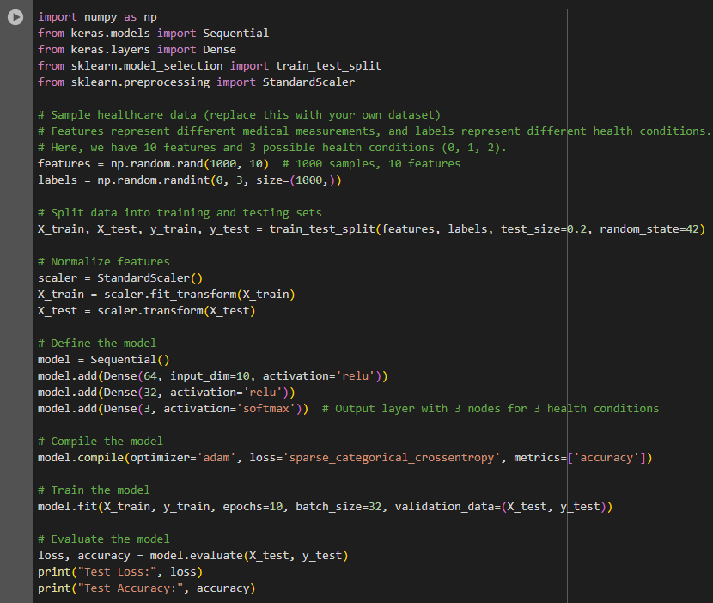
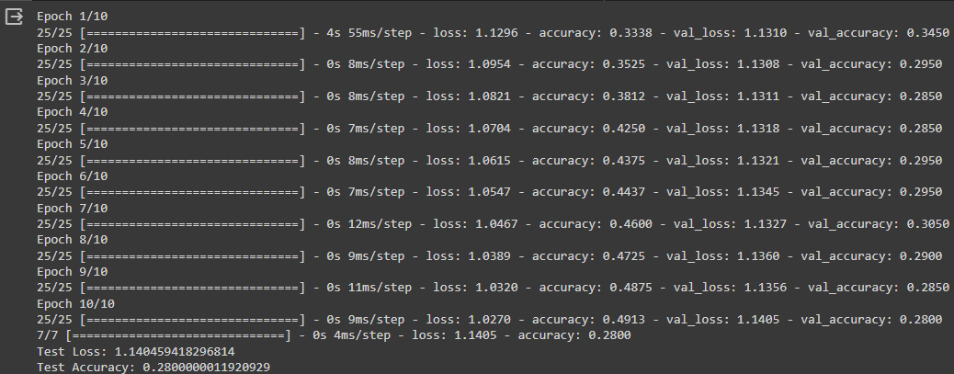
Result

